Slide 1


Follow School Bus Safety Rules Every Day
A Guide to Safe Travel for Students
Welcome to School Bus Safety.
Learn the rules to ensure the safest means of travel to and from school.
Always listen to your bus driver — they are responsible for your safety.
Follow all instructions carefully to keep yourself and others safe every day.

Slide 2
Behave Safely and Respectfully on the School Bus
Seat Rules
Go directly to your assigned seat and sit facing forward at all times while the bus is in motion.
Noise & Aisles
Loud or noisy behavior is prohibited.
Keep the aisle clear of hands, feet, and objects at all times.
General Conduct
Do not eat or drink on the bus without permission.
Do not open windows without permission from the driver.
Respect the driver, follow the rules, and enjoy the ride.
PRSD Parent Information Pamphlet - Bus Rules link

Slide 3
Bus Respect & Field Trip Expectations
Important Reminders for All Students and Supervising Staff
Student Conduct Rules
• Respect Drivers & Peers: Follow driver instructions immediately and keep noise levels low.
• No Food or Drink: Eating and drinking on the bus are strictly prohibited.
• Keep It Clean: Take all garbage with you—do not throw trash on seats or floors.
• Stay Seated: Sit facing forward at all times while the bus is in motion.
Staff & Chaperone Responsibilities
• Active Supervision: Staff must actively monitor student behavior throughout the entire trip.
• Support the Driver: Address yelling, disrespect, or unsafe behavior immediately.
• Post-Trip Clean Up: Ensure all trash and personal belongings are cleaned off the bus upon trip completion.
• Accountability: Staff are directly responsible for the group's conduct and safety.
Shared Responsibility for a Safe Ride
A respectful and clean bus environment ensures safe travel for everyone. Thank you to our students and staff for treating our drivers and buses with care!

Slide 4
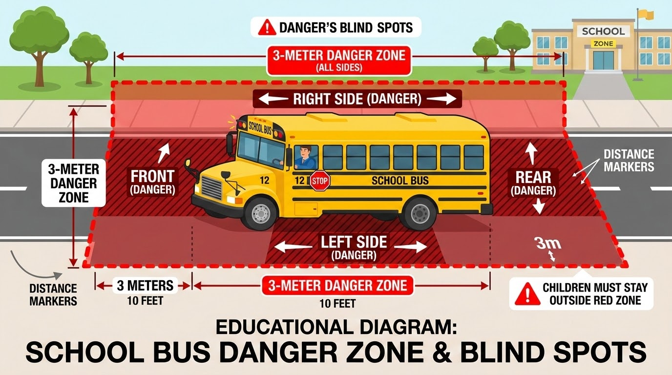
Stay Out of the Three-Meter Danger Zones
All areas around the school bus are dangerous, but the danger zone is specifically an area 3 meters around the entire school bus.
The two most dangerous zones are directly in front of the bus and along the right rear side, as these are the areas the driver has the most difficulty seeing.
SAFETY RULE:
If you drop something under the bus, never reach for it; tell the driver or an adult instead.

Slide 5
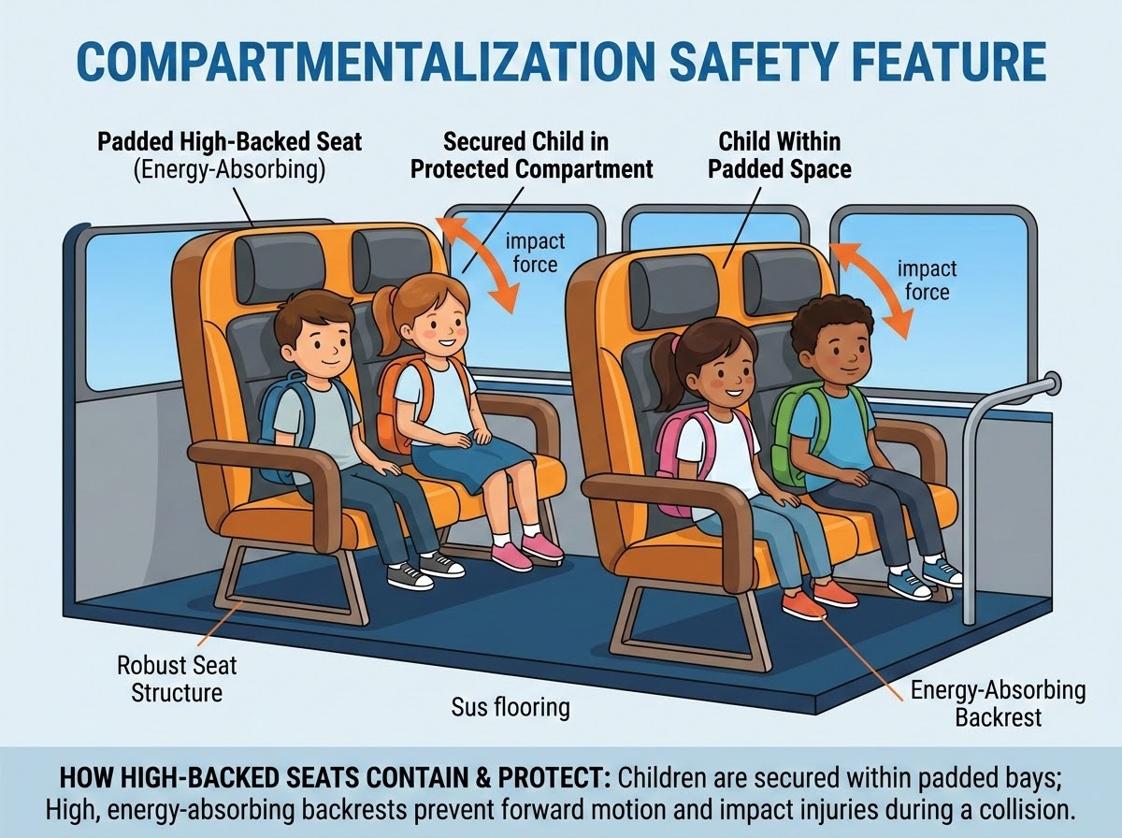
Follow Instructions Carefully During Bus Evacuations
Evacuation Guidelines
School buses do not have seat belts; instead, they use thick padding and high seats in a design called compartmentalization.
Unless there is an emergency, never touch the emergency exit handles on the doors, windows, or roof hatches.
During a rear door evacuation, students must watch their heads as they exit out the back of the bus.
The driver will provide clear and concise instructions to the helpers and leader.

Slide 6
PRSD School Bus Rider Rules
Essential Guidelines from the Parent & Guardian Handbook
At the Bus Stop
Arrive 3–5 minutes before pickup time.
Stand well back in designated safe zone.
Wait for complete stop before boarding.
Cross 3 meters in front of the bus.
Line up single file; do not push.
On the Bus Conduct
Go straight to assigned seat; face forward.
Keep aisles clear of feet, hands & bags.
Loud or noisy behavior is prohibited.
Do not open windows without permission.
No eating or drinking on the bus.
Safety & Compliance
Follow bus driver directions at all times.
Dress appropriately for weather conditions.
Report bullying or harassment immediately.
Keep garbage off floor & inside bus.
Tobacco & alcohol products prohibited.
Driver Authority & Student Safety
The bus driver is responsible for passenger safety. Follow driver directions at all times, and inform them when service is not required.

Slide 7

School Bus Safety Videos
Educational Resources & Training Videos
1. Bus Evacuation Videos
2. Bubbly Productions School Bus Safety with Rules
3. Winnie the Pooh Bus Safety
4. School Bus Safety Tips Video
Educational Video Library
Watch these engaging video resources with students to review essential riding rules, evacuation procedures, and safety guidelines.
5. Kids Guide to Bus Safety

Slide 8
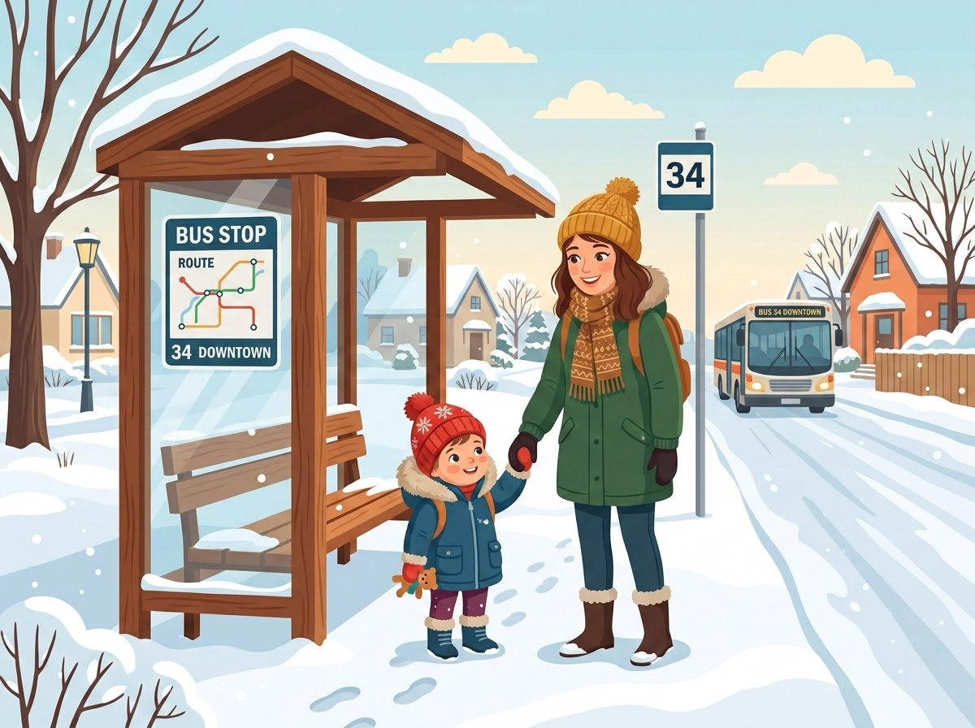
Parents and Guardians Share Responsibility for Bus Safety
Supervision & Boarding Safety
Parents and guardians are responsible for the safety of their children prior to boarding and after disembarking. All Kindergarten and Grade 1 students must be met by a responsible adult on and off the bus.
Weather Preparedness
Ensure children are properly dressed for weather conditions in case of breakdown or delays.
Cold Weather Cancellation Rule
Morning and afternoon buses are cancelled if the temperature at 6 a.m. is -35°C or colder without wind chill. Refer to AP-567 cold and inclement weather for more information.
Safety First
Working together to ensure a safe, warm commute for every child.

Slide 9

Safety Theme: "Be Bright, Stay in Sight"
Summary Safety Checklist
Expect the Unexpected
Always expect the unexpected, as sometimes grown-ups in other vehicles are in a hurry and don't stop for the school bus.
Safest Means of Travel
Following these rules provides the safest means of travel to and from school.
School Bus Safety Theme
This theme is a reminder to students to remain in a safe area while waiting for the bus and to wear bright or reflective clothing through the dark winter months.
Be Bright, Stay in Sight!
Always maintain awareness around bus stops.

Slide 10
Summary Safety Checklist
Be Aware, Careful & Safe
Safest Means of Travel
Every time you are near a school bus, remember to be aware, be careful, and be safe.
By following our shared safety guidelines, students, parents, and drivers make every journey secure and smooth.
Following these rules provides the safest means of travel to and from school.
Safety First!
Celebrating safe student transportation every single day.
Working together to ensure a safe, warm commute for every child.

